Slide 1
COT 4600 Operating Systems Fall 2009
Dan C. Marinescu
Office: HEC 439 B
Office hours: Tu-Th 3:00-4:00 PM

Slide 2
Lecture 26
Schedule
Tuesday November 24 - Project phase 4 and HW 6 are due
Tuesday December 1st -Research projects instead of final exam presentation
Thursday December 3rd - Class review
Last time:
Scheduling
Today: (Chapter 7) - available online from the publisher of the textbook
More on Scheduling
Network properties
Layers
Link layer
Next Time:
Network layer
Transport layer
2
2
2
2
2

Slide 3
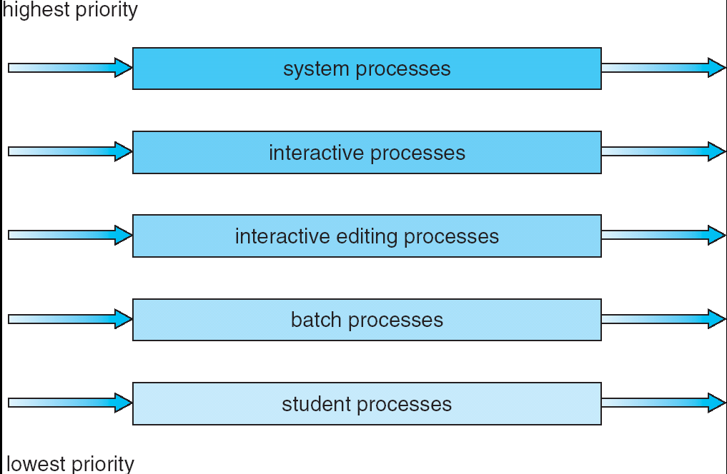
Multilevel Queue Scheduling
Notes:
3

Slide 4
Multilevel feedback queue
A process can move between the various queues; aging can be implemented this way
Multilevel-feedback-queue scheduler characterized by:
number of queues
scheduling algorithms for each queue
strategy when to upgrade/demote a process
strategy to decide the queue a process will enter when it needs service
Notes:
4

Slide 5
Example of a multilevel feedback queue exam
Three queues:
Q₀ – RR with time quantum 8 milliseconds
Q₁ – RR time quantum 16 milliseconds
Q₂ – FCFS
Scheduling
A new job enters queue Q₀ which is served FCFS. When it gains CPU, job receives 8 milliseconds. If it does not finish in 8 milliseconds, job is moved to queue Q₁.
At Q₁ job is again served FCFS and receives 16 additional milliseconds. If it still does not complete, it is preempted and moved to queue Q₂.
Notes:
5

Slide 6
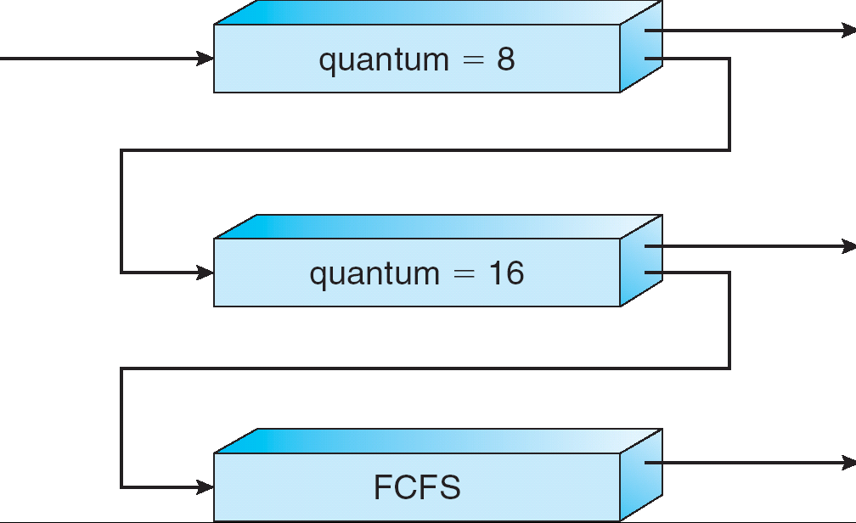
Multilevel Feedback Queues
Notes:
6

Slide 7
Unix scheduler
The higher the number quantifying the priority the lower the actual process priority.
Priority = (recent CPU usage)/2 + base
Recent CPU usage ➔ how often the process has used the CPU since the last time priorities were calculated.
Does this strategy raises or lowers the priority of a CPU-bound processes?
Example:
base = 60
Recent CPU usage: P1 =40, P2 =18, P3 = 10
Notes:
7

Slide 8
Comparison of scheduling algorithms
 | Round Robin | FCFS | MFQ Multi-Level Feedback Queue | SFJ Shortest Job First | SRJN Shortest Remaining Job Next
Throughput Response time | May be low is quantum is too small Shortest average response time if quantum chosen correctly | Not emphasized May be poor | May be low is quantum is too small Good for I/O bound but poor for CPU-bound processes | High Good for short processes But maybe poor for longer processes | High Good for short processes But maybe poor for longer processes
Notes:
8

Slide 9
 | Round Robin | FCFS | MFQ Multi-Level Feedback Queue | SFJ Shortest Job First | SRJN Shortest Remaining Job Next
IO-bound Infinite postponement | No distinction between CPU-bound and IO-bound Does not occur | No distinction between CPU-bound and IO-bound Does not occur | Gets a high priority if CPU-bound processes are present May occur for CPU bound processes | No distinction between CPU-bound and IO-bound May occur for processes with long estimated running times | No distinction between CPU-bound and IO-bound May occur for processes with long estimated running times
Notes:
9

Slide 10
 | Round Robin | FCFS | MFQ Multi-Level Feedback Queue | SFJ Shortest Job First | SRJN Shortest Remaining Job Next
Overhead CPU-bound | Low No distinction between CPU-bound and IO-bound | The lowest No distinction between CPU-bound and IO-bound | Can be high Complex data structures and processing routines Gets a low priority if IO-bound processes are present | Can be high Routine to find to find the shortest job for each reschedule No distinction between CPU-bound and IO-bound | Can be high Routine to find to find the minimum remaining time for each reschedule No distinction between CPU-bound and IO-bound
Notes:
10

Slide 11
Terminology for scheduling algorithms
A scheduling problems is defined by :
The machine environment
A set of side constrains and characteristics
The optimality criterion
Machine environments:
1 ➔ One-machine.
P ➔ Parallel identical machines
Q ➔ Parallel machines of different speeds
R ➔ Parallel unrelated machines
O ➔ Open shop. m specialized machines; a job requires a number of operations each demanding processing by a specific machine
F ➔ Floor shop

Slide 12
One-machine environment
n jobs ➔1,2,….n.
p_{j} ➔amount of time required by job j.
r_{j} ➔ the release time of job j, the time when job j is available for processing.
w_{j} ➔ the weight of job j.
d_{j}➔ due time of job j; time job j should be completed.
A schedule S specifies for each job j which p_{j} units of time are used to process the job.
C^{S}_{j} ➔ the completion time of job j under schedule S.
The makespan of S is: C^{S}_{max} = max C^{S}_{j}
The average completion time is

Slide 13
One-machine environment (cont’d)
Average weighted completion time:
Optimality criteria ➔ minimize:
the makespan C^{S}_{max}
the average completion time :
The average weighted completion time:
➔ the lateness of job j
➔ maximum lateness of any job under schedule S. Another optimality criteria, minimize maximum lateness.

Slide 14
Priority rules for one machine environment
Theorem: scheduling jobs according to SPT – shortest processing time is optimal for
Theorem: scheduling jobs in non-decreasing order of
is optimal for

Slide 15
Real-time schedulers
Soft versus hard real-time systems
A control system of a nuclear power plant → hard deadlines
A music system → soft deadlines
Time to extinction → time until it makes sense to begin the action

Slide 16
Earliest deadline first (EDF)
Dynamic scheduling algorithm for real-time OS.
When a scheduling event occurs (task finishes, new task released, etc.) the priority queue will be searched for the process closest to its deadline. This process will then be scheduled for execution next.
EDF is an optimal scheduling preemptive algorithm for uniprocessors, in the following sense: if a collection of independent jobs, each characterized by an arrival time, an execution requirement, and a deadline, can be scheduled (by any algorithm) such that all the jobs complete by their deadlines, the EDF will schedule this collection of jobs such that they all complete by their deadlines.
16

Slide 17
Schedulability test for Earliest Deadline First
Process | Execution Time | Period
P1 | 1 | 8
P2 | 2 | 5
P3 | 4 | 10
In this case U = 1/8 +2/5 + 4/10 = 0.925 = 92.5%
It has been proved that the problem of deciding if it is possible to schedule a set of periodic processes is NP-hard if the periodic processes use semaphores to enforce mutual exclusion.
17

